Slide 1
Living Things as a Resource

Slide 2
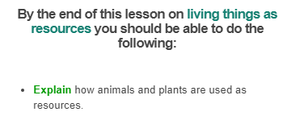
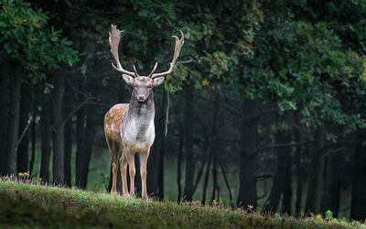

Slide 3
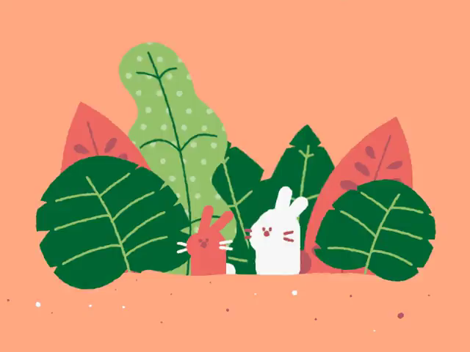
Did you know that living things are resources?
It might seem strange to think of plants and animals as resources, but it's true!

Slide 4
Living things are resources because they help other living things survive.
The main ways that living things are used are:
• | as biomass
• | as food
• | as shelter
• | to help reproduction

Slide 5
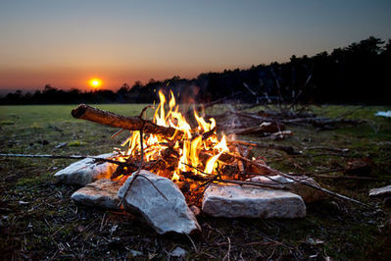
Biomass is a term used to describe energy that is obtained from materials such as dead plants, plant matter or animals and their wastes.
All of these materials contain stored energy.
One way you might use biomass as a resource is when you burn wood.
Wood contains stored energy that is released as heat energy when burnt.

Slide 6
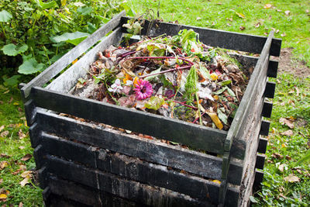
Another way that biomass can be used as a resource is through the creation of biogas.
Biogas is a fuel that can be produced through decomposing organic wastes such as fruit peelings, grass clippings, human sewage and animal wastes.
This gas can be collected and used as a fuel. This is one way to build an energy supply for the future that limits greenhouse gas emissions.

Slide 7
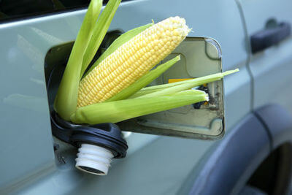
Some other ways that biomass is being used as a resource include:
Fermenting agricultural crops such as corn and sugarcane to produce fuel.
Converting vegetable oils from plant seeds such as oil palm, sunflower, canola, soybean, sesame and linseed to a biodiesel fuel.
Growing algae to produce biodiesel fuel.

Slide 8
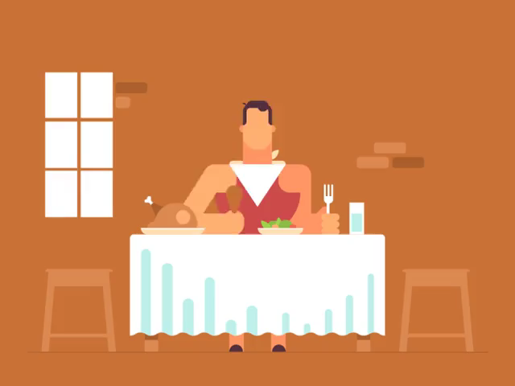
Food is considered a resource as animals and a few plants need to eat to grow and survive.
As humans we eat both plants and animals to grow and provide energy for our bodies.

Slide 9
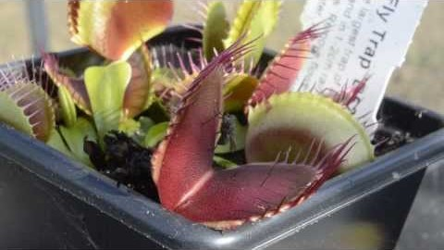

Slide 10
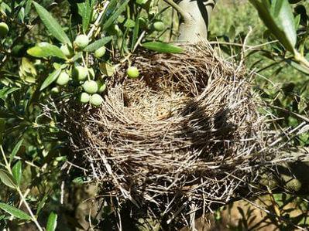
Living things can also be used as shelter.
Many organisms use other living things as shelter.
For example, a bird will build its nest in a tree out of twigs and leaves. This means that the tree is a resource for the bird.
Another example is tapeworms which live in other animals' guts. These tapeworms can grow to be 25 m long! Imagine having something that big taking shelter inside you.

Slide 11
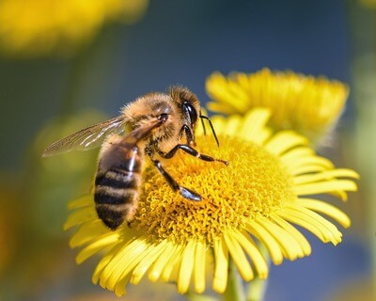
Living things can also be used to help with reproduction.
Other species can be used for reproduction.
For example, lots of plants rely on other animals to pollinate their flowers.
Some animals which help plants reproduce are bees and hummingbirds.

Slide 12
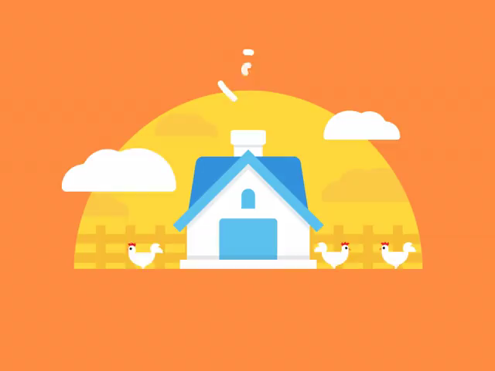
Living things are a renewable resource. This is because they can replace themselves by reproducing.
An example of this is farm animals. We kill many farm animals every year for food but we also make sure that we breed more animals to replace these. This means that we won't run out of farm animals!

Slide 13
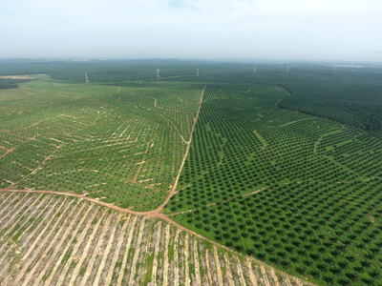
Forests which have been cut down can grow back. This means that they are also a renewable resource.
Plantations are areas of land where trees are deliberately planted by humans for their resource.
Native forests could take decades to regrow. However, plantations grow back much faster. This is good, because plantations are valuable for their timber, so are regularly cut down and need to be replaced more often.

